Slide 1
HOSPITAL MANAGEMENT SYSTEM
JAI SAXENA (02129249) (71)
MAYANK RAJ (02135041) (61)
GROUP-32

Slide 2
Agenda
INTRODUCTION
REQUIREMENTS/ USE CASE
DATABASE SCHEMA
RELATIONSHIPS
PHYSICAL MODELS
LOGICAL MODELS
TECHNOLOGIES USED

Slide 3
INTRODUCTION
A Hospital Management System (HMS) is a comprehensive, integrated information system designed to manage all aspects of a hospital's operations, such as medical, administrative, financial, and legal matters, and the corresponding processing of services.
By automating routine processes, an HMS facilitates the efficient management of patient information, appointments, medical records, billing, inventory, and more, enabling hospitals to provide high-quality care with increased efficiency and reduced operational costs.
This digital transformation not only supports healthcare providers in achieving operational excellence but also significantly contributes to patient satisfaction and safety.
the implementation of a Hospital Management System represents a critical step forward in modernizing healthcare facilities, ensuring that they can meet the evolving demands of the healthcare industry while providing superior care to their patients.

Slide 4
1. Patient Management: Facilitates registration, profile updates, and medical history management for patients. 2. Appointment Scheduling: Supports booking, rescheduling, and cancellation of appointments with doctors. 3. Medical Records Management: Allows for the creation and secure access of detailed medical records post-consultation. 4. Billing and Insurance Processing: Enables the generation of bills for services and manages insurance claims. 5. Staff and Schedule Management: Manages hospital staff details, including role, department, and work schedules. 6. Inventory Management: Tracks and manages inventory levels of medical supplies and medications
REQUIREMENTS/USE CASE

Slide 5
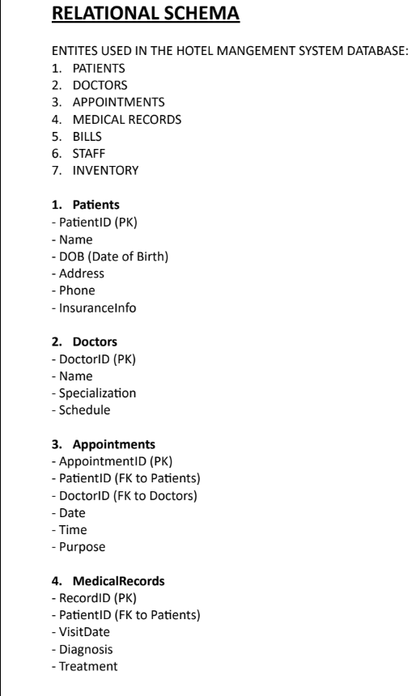
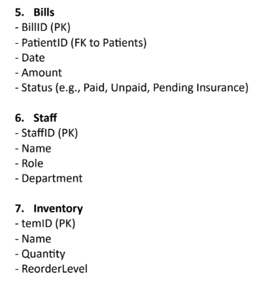


Slide 6

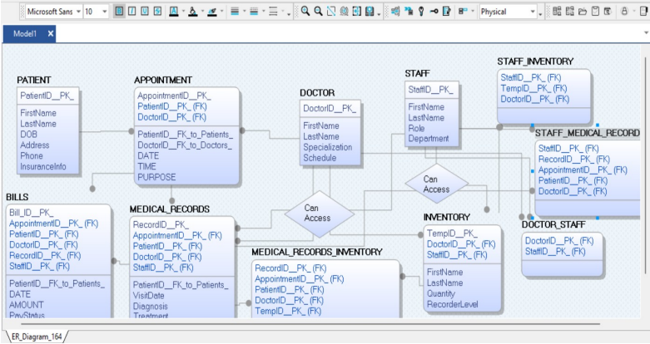
PHYSICAL MODEL

Slide 7
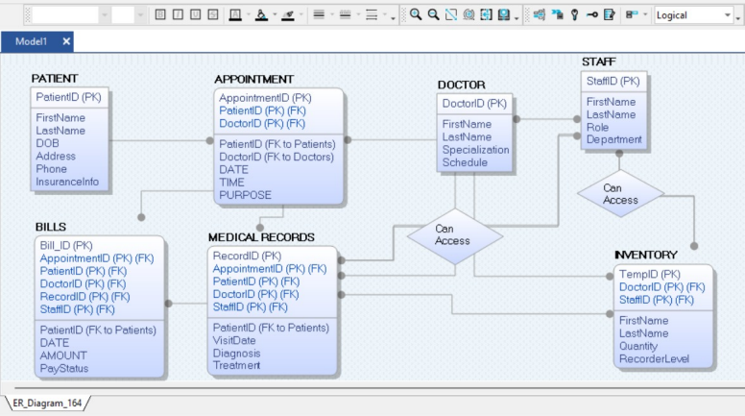
LOGICAL MODEL

Slide 8
TECHNOLOGIES USED
LANGUAGE- PYTHON
UI- (JINJA2- FLASK)
FRAMEWORK- FLASK
API- REST
DATABASE- MYSQL

Slide 9

GROUP- 32

